Slide 1

SOCIAL TRENDS IN COMPUTER GAMING 1

Slide 2
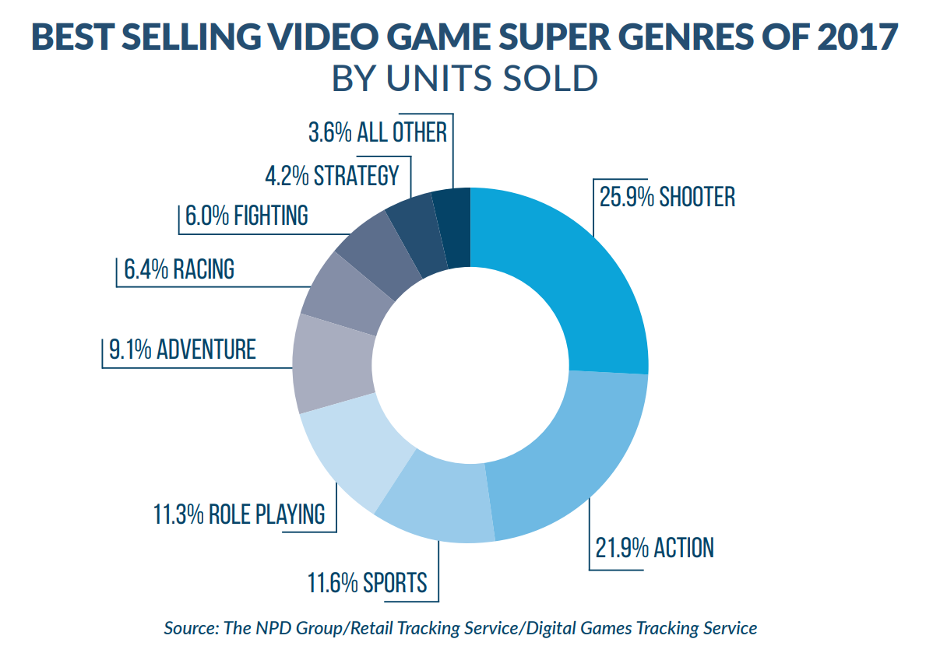
Popular Genres
Over the years popular game genres have changed. | This is due to changing technology & society.
In 2017 the most popular genres were Shooter & Action.
In the year 2000 we saw more RPGs & less shooters.
This has been pretty consistent for a few years with action & shooter swapping places occasionally.
Top selling games were Pokemon Silver, Gold & Yellow.
The Battle Royale sub-genre of shooter has seen a particularly large growth in recent years.
No shooter games, only 1 action and 1 sport game in top 10.
http://www.theesa.com/about-esa/essential-facts-computer-video-game-industry/

Slide 3
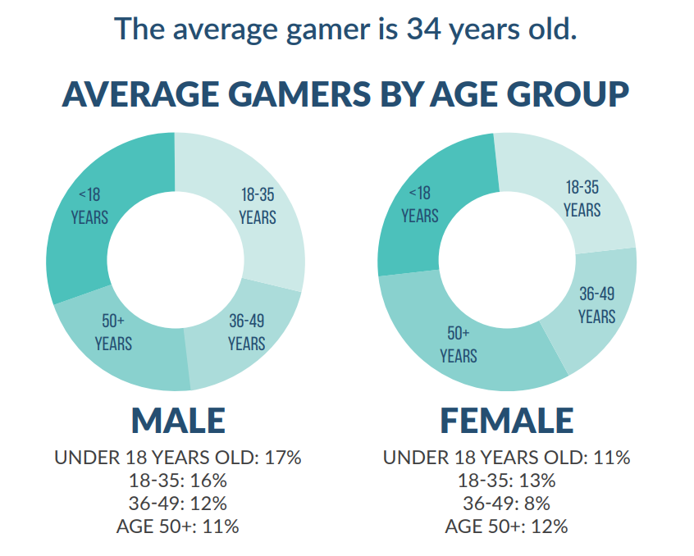
Players
Gaming has grown into the mainstream. | Players come from wide range of demographics.
Gender
Age
55% of gamers are male, 45% are female.
The average gamer is 34 years old (Male 36, Female 32).
The most common age group is <18 for male & 18-35 for female.
Shooter, Sports & Action/Adventure most popular men.
Action/Adventure, Strategy & Arcade most popular with women.
http://www.theesa.com/about-esa/essential-facts-computer-video-game-industry/

Slide 4
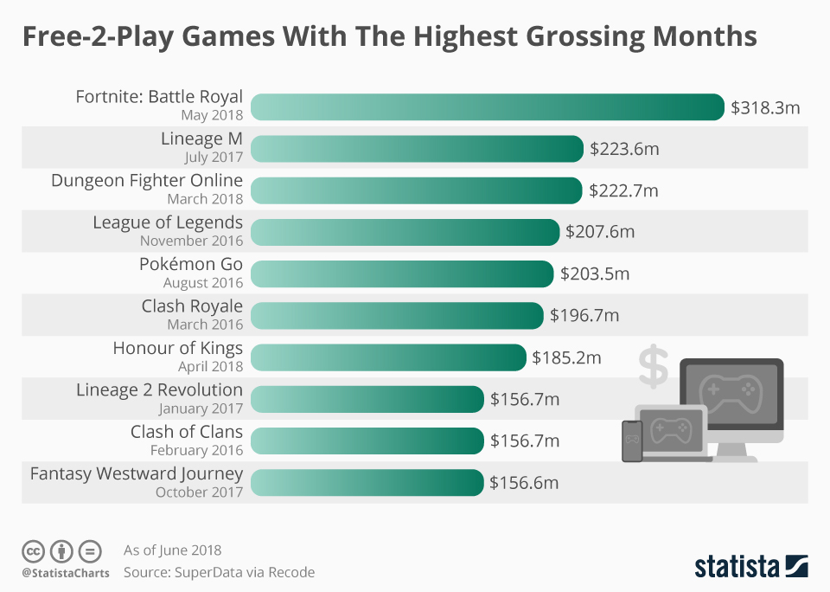
Game Production
Game developers & publishers have also changed over the years.
Main Stream / Independent
Paid / Free-to-Play
It is easier than ever to self-publish games due to platforms like Steam, Android Play Store & Apple App Store.
A huge growth in free-to-play has been seen in recent years.
Funding through crowd-funding sites also made independent publishing easier.
Digital distribution & micro-transactions make this possible.
Driven by mobile but popular on PC and growing on console.
https://www.statista.com/chart/14479/free-2-play-games-highest-grossing-months/

